Slide 1

SCET-MITWPU Depression Detection in humans using Machine Learning Machine Learning and Web development
Project Title:Depression detection system using python & web development
Team member Details:
SR NO. | NAME | ROLL NO. | PRN | PANEL
1. | Aryan Bansal | 25 | 1032211329 | B
2. | Aerth saraogi | 21 | 1032211208 | B
3. | Akshit Singh | 30 | 1032211401 | B
4. | Sai Venktesh Dubey | 33 | 1032211476 | B
Name of BTech Capstone Project Guide : Mrs. Laxmi Bhagwat
Is the project inhouse/industry sponsored : In House
Number of Time Students met the Project Guide :5
Are the slides approved by Project Guide YES/NO:YES
10/24/2024

Slide 2
Index
S.no. | Table of Contents | Page No.
1. | Problem Statement | 8
2. | Literature Survey | 4
3. | Requirements Gathering | 11
4. | Project Timeline | 44
5. | System Design [Team] | 15
6. | System Design [Individually] | 30
7. | Future Aspects | 47
8. | References | 49

Slide 3
Introduction
Depression is a highly common and incapacitating mental health condition on a global scale. Defined by ongoing feelings of sadness, lack of interest, and cognitive problems, depression greatly affects people's quality of life and plays a major role in global disability and mortality rates. Although clinical interviews and self-report questionnaires like the PHQ-8 are helpful, they are sometimes subjective, lead to delays in diagnosis, and may not be easily accessible. The increasing need for more scalable, objective, and automated solutions has led to a significant rise in the use of Artificial Intelligence (AI) and Machine Learning (ML) in mental health.This project seeks to utilize AI technologies to develop a thorough Depression Detection System by integrating psychological assessments and analyzing physiological data. More specifically, the system combines a Naive Bayes classifier/Support vector machine for analyzing quiz responses and a CNN model for assessing facial expressions in real-time, offering a comprehensive method for identifying depression. By including cognitive as well as emotional signs of depression, this system provides an improved diagnostic tool that can identify states of depressive conditions.

Slide 4
Literature Survey
Sr No. | Publication Title with Authors | Publication Year | Introduction | Gaps in Publication work | Future Research | Conclusion
1. | Predicting Depression: a comparative study of machine learning approaches based on language usage- Luciana Mariñelarena Dondena, Edgardo Ferretti, M. Maragoudakis, Maximiliano Sapino, M. Errecalde | 2017- Journal | The introduction talks about depression, a condition that affects more than 332 million people around the world. Cases have been growing since 2000. People with depression often lose interest in things they once enjoyed. Sometimes, they even have thoughts about hurting themselves. This really shows how important it is to spot these signs early & to find good treatments like CBT. | We really need to take extra steps beyond just using classification techniques. Class imbalance in training data? It's still a tough problem. | Explore some new ways to manage class imbalance. There are different text mining techniques out there for checking psychological health. | Deep learning has really taken the lead when it comes to spotting depression. In fact, when you mix SMOTE with deep learning, you can get over 94% accuracy.
10/24/2024

Slide 5
2. | Ensemble Hybrid Learning Methods for Automated Depression Detection- LunaAnsari,Shaoxiog Ji,ChenQian,Erik Cambria | 2023 - Journal | The introduction shines a light on how depression is becoming more common. It might even be one of the biggest health problems by 2030! The text also looks at using language patterns to help figure out if someone has depression automatically, even though there are issues like stigma & misdiagnosis. | To improve how we detect depression, future studies should look into fairness, bias, uncertainty, & how we explain the results. | Think about using POS tags & working on imbalanced datasets. You can also look into how user personalities connect to depression indicators. | Ensemble models do a better job than hybrid ones for figuring out depression. By using a bunch of different language features, we see an improvement in how effectively we can find signals of depression.
3. | Automatic Detection of Depression by Using a Neural Network.- Mahsa Raeiati Banadkooki , Corinna Mielke, Klaus-Hendrik Wolf , Reinhold Haux , Michael Marschollek | 2018 - Journal | The introduction mentions that depression affects over 300 million people worldwide! There’s a big need for better ways to detect it. The authors took the PHQ-9 questionnaire and made it simpler by using PHQ-5. They changed the rules a bit for spotting depression. | This study looks at recent surveys and finds a big gap in automatically spotting depression. The authors have changed the standard cut-off from PHQ-9 to PHQ-5. But they say we need more proof to back this up. | In the future, research should focus on better depression detection models. Adding more data, like physiological information, could really help with diagnosis. | Neural networks have shown great success too. The PHQ-5 questionnaire, especially with a cut-off score of 8, is quite good at helping identify depression.
10/24/2024

Slide 6
4. | Implementation and Analysis of Depression Detection Model using Emotion Artificial Intelligence- Unnati Chawda, Shanu K Rakesh | 2019 - Journal | The introduction addresses how concerning depression can be for people's physical health and everyday life, including school. Early detection is super important. It even suggests using Natural Language Processing to look at tweets on Twitter for helpful insights! | One key issue highlighted in the study is how we diagnose depression early by using real-time data from social media. There’s a need for models that can check language trends on Twitter and other platforms with Natural Language Processing. | Future studies should make emotion detection algorithms even more accurate. It can include different social media types & check out how culture and language play a role in showing mental health issues. | For building a depression detection model, emotion AI & natural language processing are super useful. With some Python code.
5. | Depression Detection on Social Media- RafaelSalas-Zárate,Giner Alor-Hernández,María del Pilar Salas-Zárate,Mario Andrés Paredes-Valverde,Maritza Bustos-López,José Luis Sánchez-Cervantes4 | 2022 - Journal | The things getting worse with depression, social media might be a way to help find symptoms quicker. The idea is to mix past data with real-time info—this could make detecting depression much more accurate. They’re thinking about using machine learning and topic modeling to do this! | The research points out a weakness when it comes to using messy social media data for spotting depressive symptoms effectively. It calls for better frameworks that blend advanced machine learning with big data processing to make sense of things. | Let’s aim to improve depression detection algorithms by using various data sources & advanced natural language processing. | The Twitter data can be helpful in spotting symptoms of depression. A chatbot could help users who are feeling down; that’s a neat idea.
10/24/2024

Slide 7
Research Gaps
Following are some research Gaps observed during literature review:
1.Lack of Real-Time Data: Most systems rely on static datasets and lack real-time physiological data, such as facial expressions.
2. Emotion Recognition Challenges: Current models struggle with accurately identifying emotions in diverse conditions.
3. Bias and Fairness: Many models lack fairness and often exhibit bias, with limited ability to explain results.
4.Limited Integration: Few studies effectively combine psychological assessments with physiological indicators like facial expressions for a more comprehensive diagnosis.
10/24/2024

Slide 8
Problem Statement
This project aims to address these gaps by developing a Depression Detection System that integrates a diagnostic quiz with real-time facial expression analysis. The system will use a classifier for quiz-based depression detection and a Convolutional Neural Network (CNN) for real-time emotion recognition.
The objectives of Solution are:
1. Incorporate Real-Time Data through facial expression analysis.
2. Enhance Emotion Detection Accuracy using CNN models.
3. Ensure Fairness and Reliability by providing a more comprehensive diagnostic tool that combines psychological and physiological data
10/24/2024

Slide 9
Requirements Gathering
Non-Functional Requirements Usability: Intuitive user interface for all technical expertise levels Performance: Efficient real-time facial expression analysis. Scalability: Accommodate a large user base with quick responses. Security: Secure storage and processing of user data. Functional Requirements Quiz Module Diagnostic quiz with multiple-choice questions. Naive Bayes classifier for depression type assessment. Recommendations for clinics and experts. Interactive map for treatment facility location. | Facial expression analysis Module Users record a one-minute video or photo about themselves. CNN analyses facial expressions for emotional evaluation. Real-time data processing for refined diagnosis. Frontend-Backend Integration Seamless interface with HTML, CSS, JavaScript frontend. User data stored in a MongoDB database. Robust handling of quiz and emotion recognition errors. Hardware Requirements High-Performance GPU (e.g., NVIDIA RTX 3090) Microphone and camera for real-time capture. High-capacity SSD storage.
10/24/2024

Slide 10
Requirements Gathering
Software Requirements
Backend Processing
Python with FASTAPI
NodeJS with JavaScript
Frontend Development
HTML,CSS,JS
Bootstrap & ReactJS
Machine Learning Libraries & Algorithms
Libraries: OpenCV,Keras,Scikit-Learn,Tensorflow
Algorithms: Naïve Bayes Algorithm, Convolutional Neural Network(CNN)
10/24/2024

Slide 11
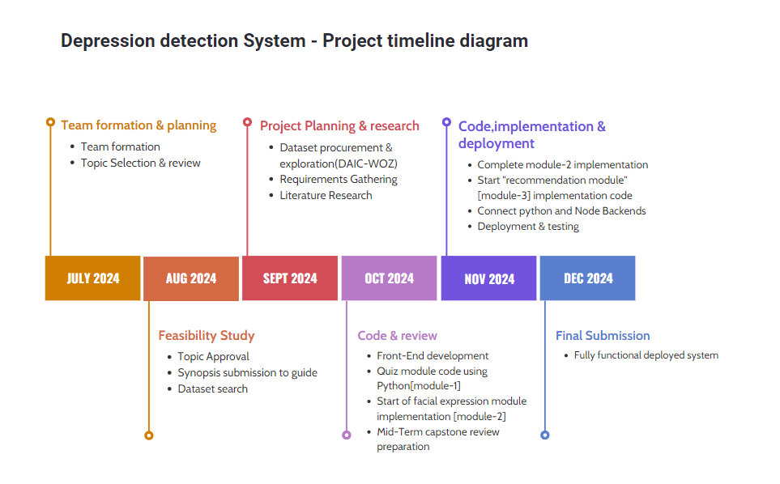
Project Timeline Diagram
10/24/2024

Slide 12
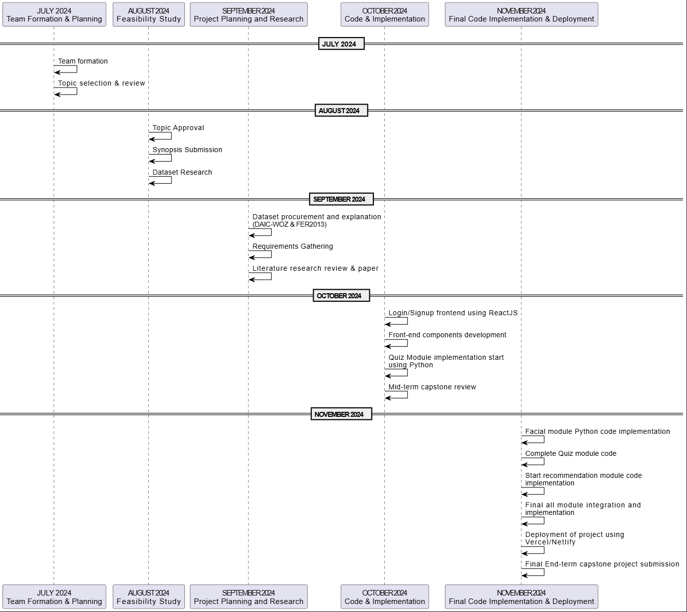
Project Timeline Diagram
10/24/2024

Slide 13
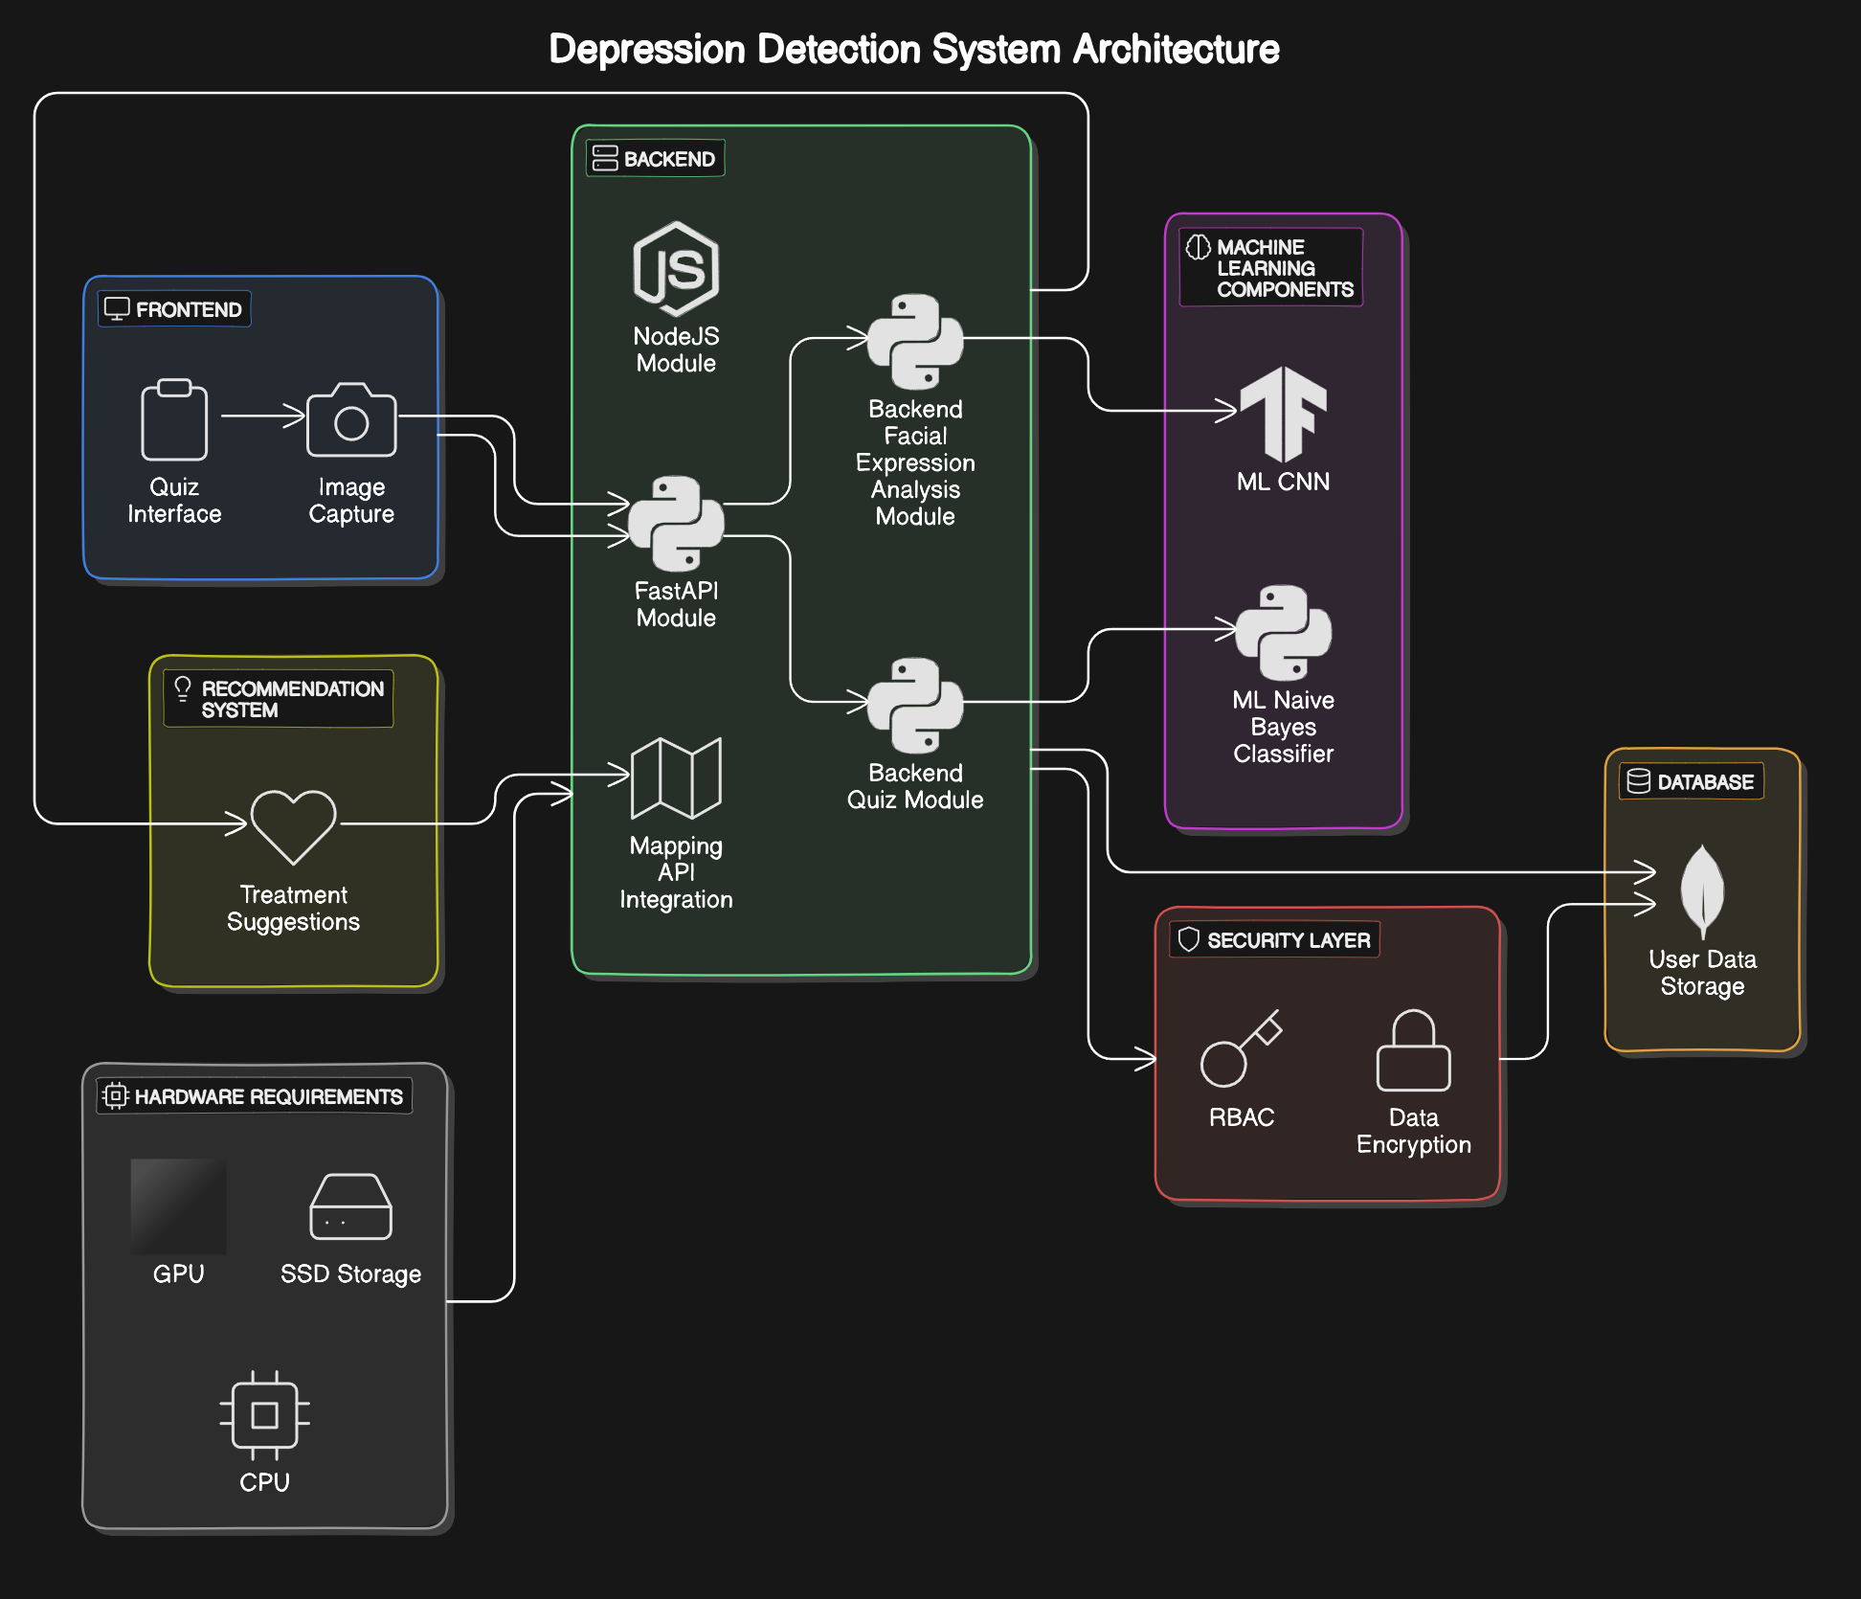
System Design [ Entire system] - Team Approach
UML diagram for depicting System Design-
System-architecture diagram High-level
10/24/2024

Slide 14
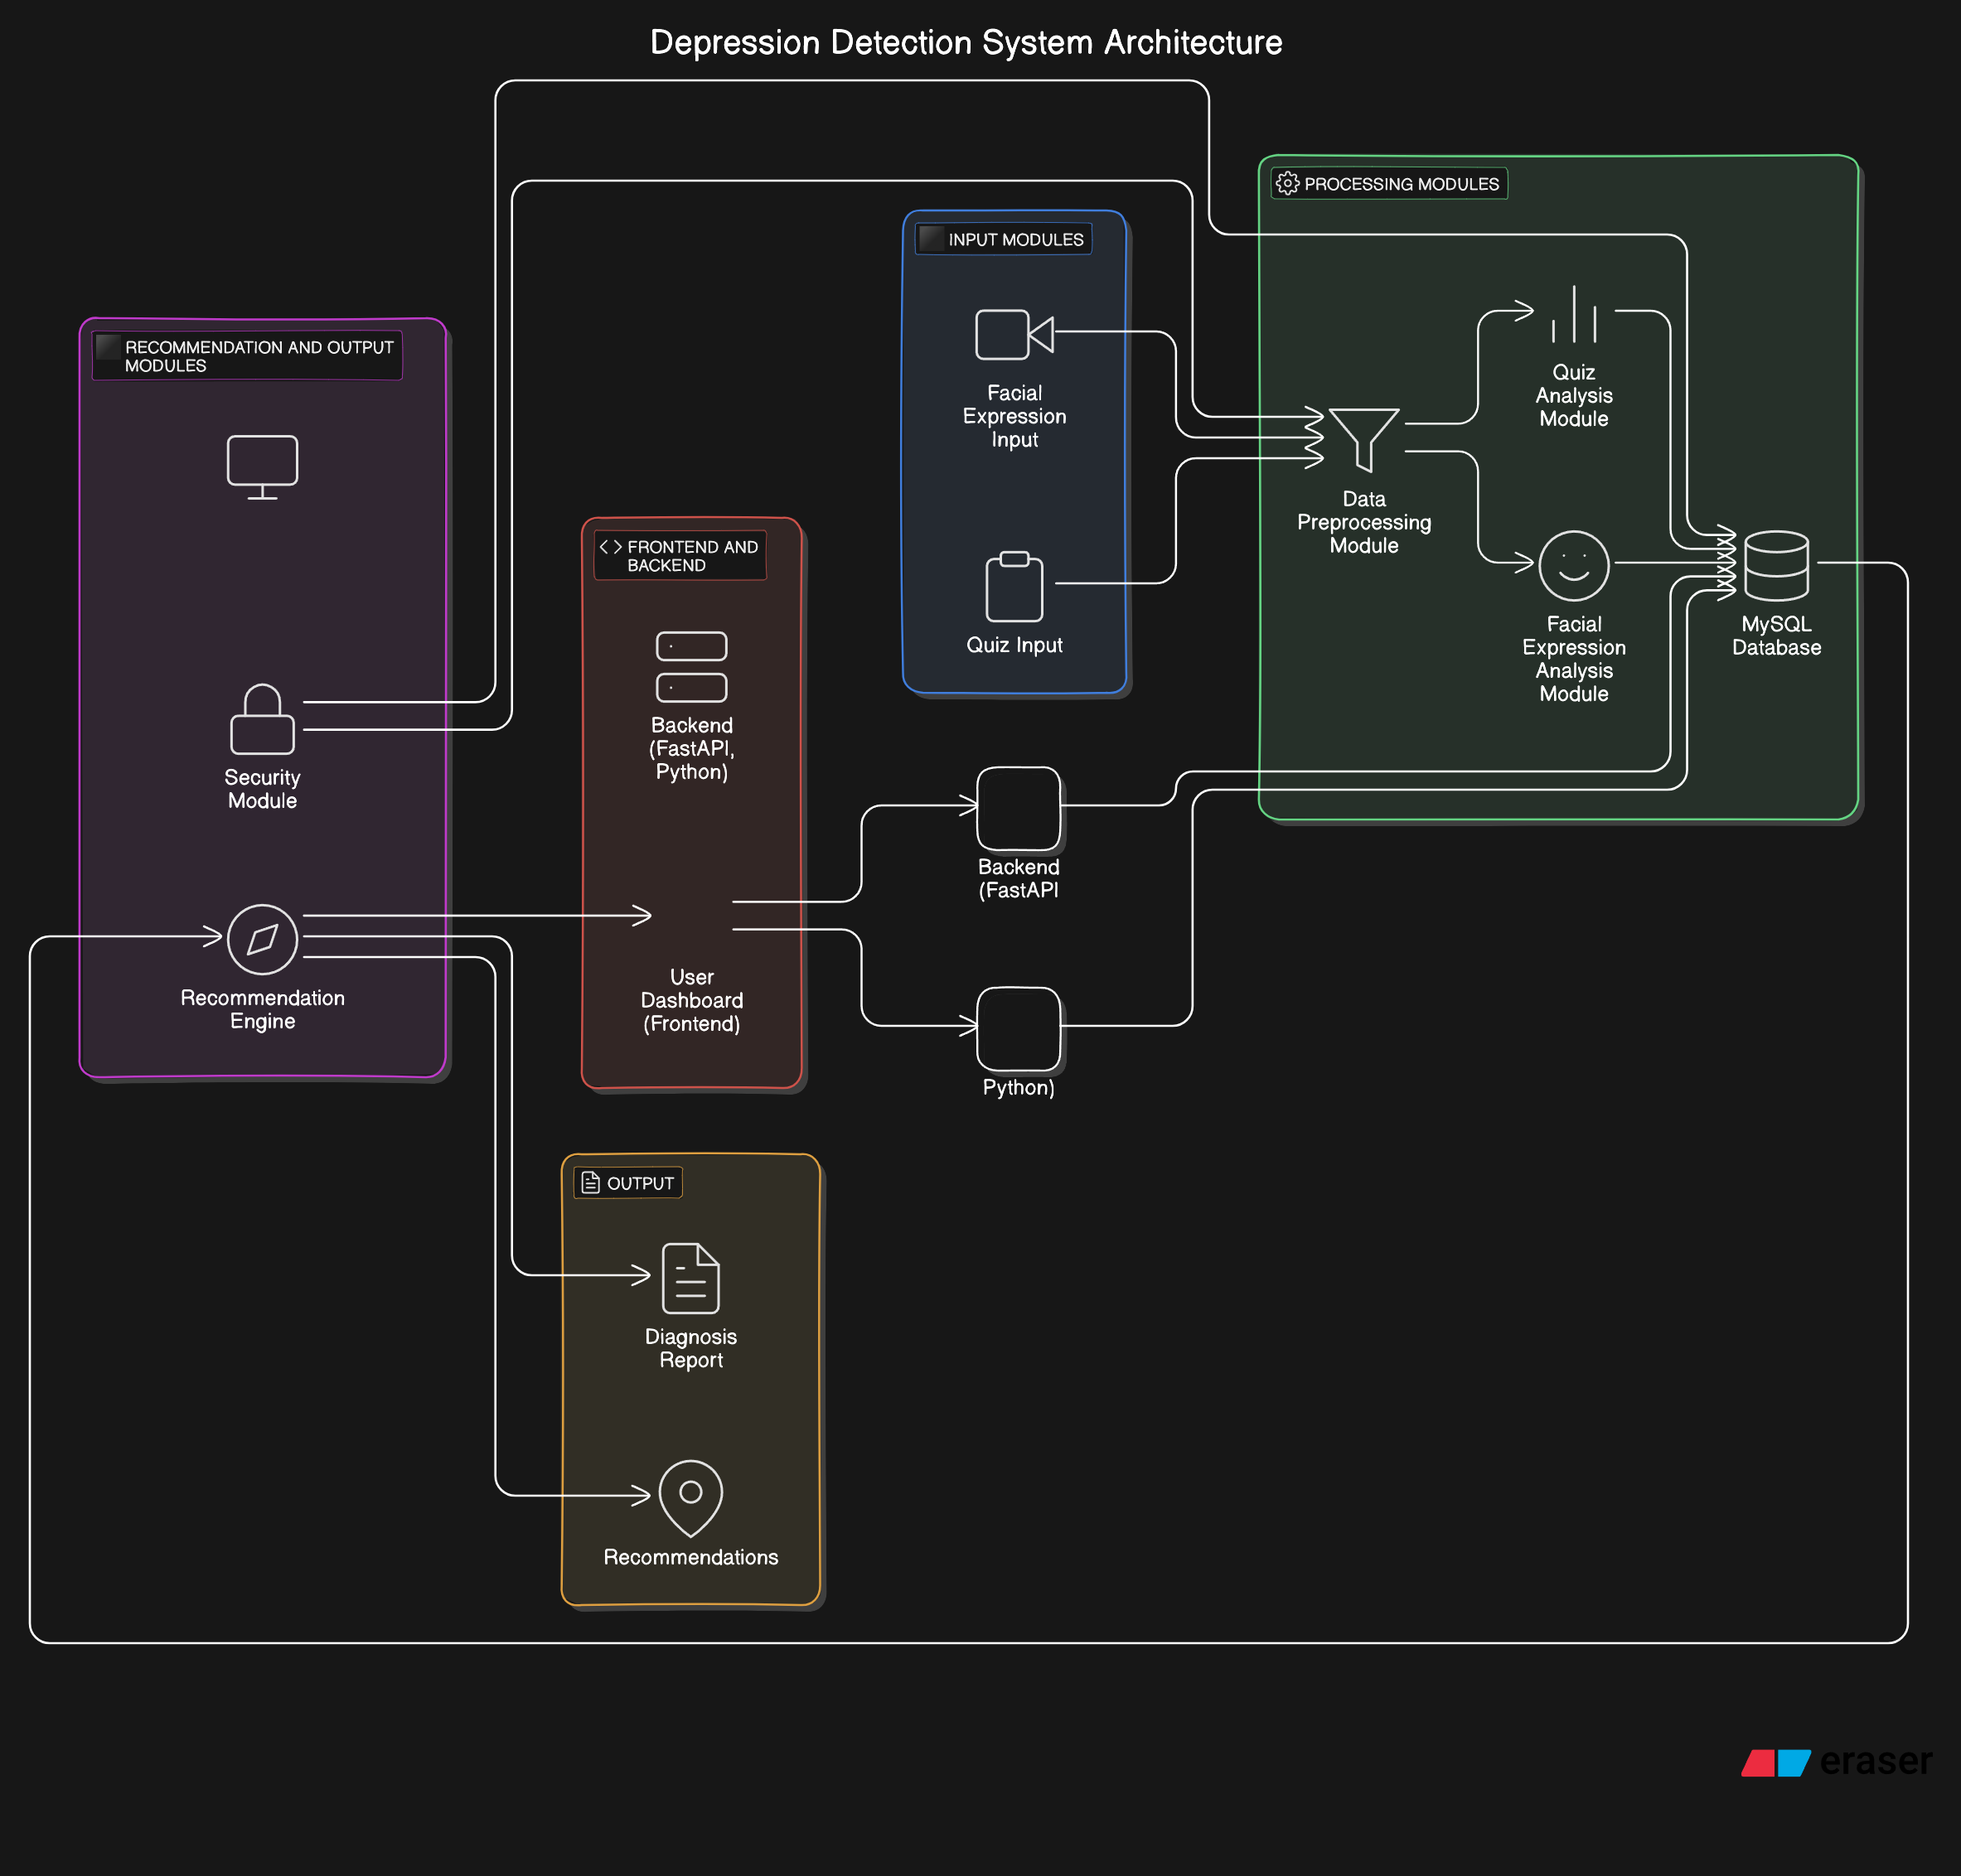
System Design [ Entire system] - Team Approach
UML diagram for depicting System Design-
System-architecture diagram low-level
10/24/2024

Slide 15
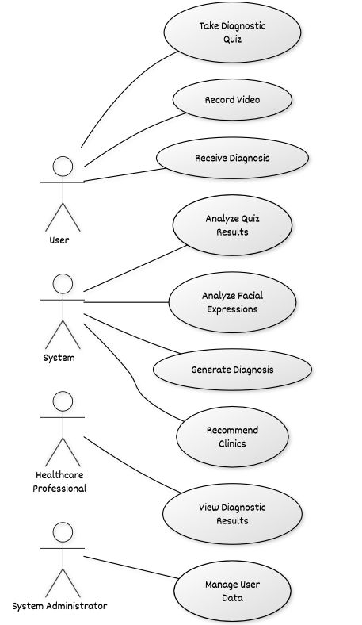
System Design [ Entire system] - Team Approach
2. Use-case Diagram
10/24/2024

Slide 16
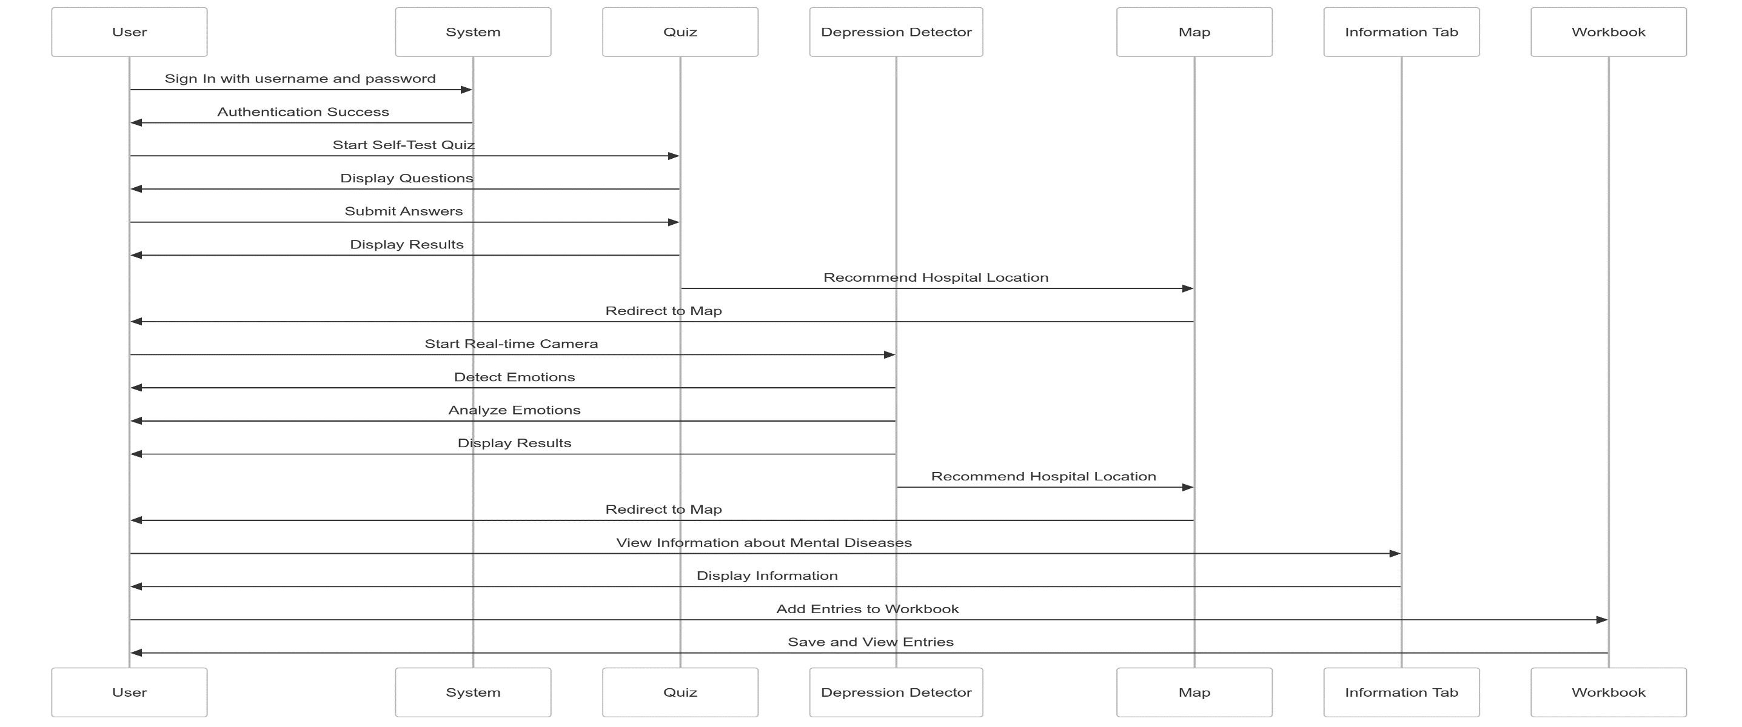
System Design [ Entire system] - Team Approach
3. Sequence diagram
10/24/2024

Slide 17
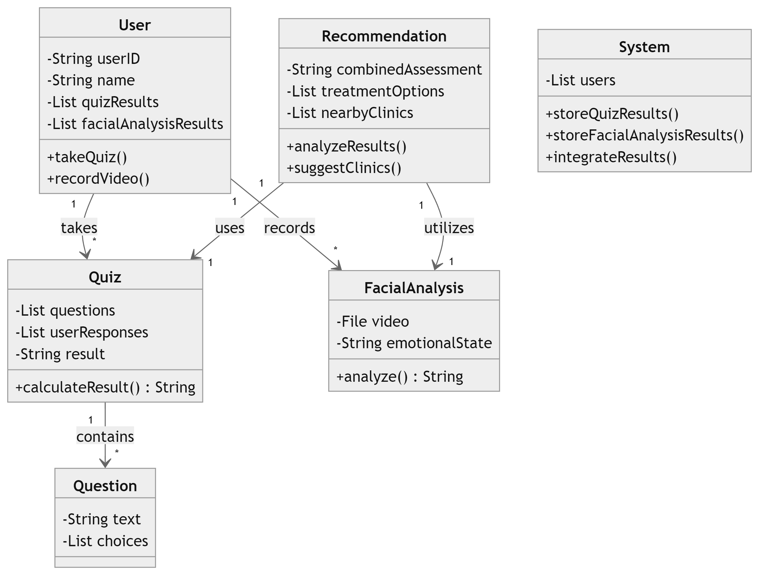
System Design [ Entire system] - Team Approach
3. Class diagram
10/24/2024

Slide 18
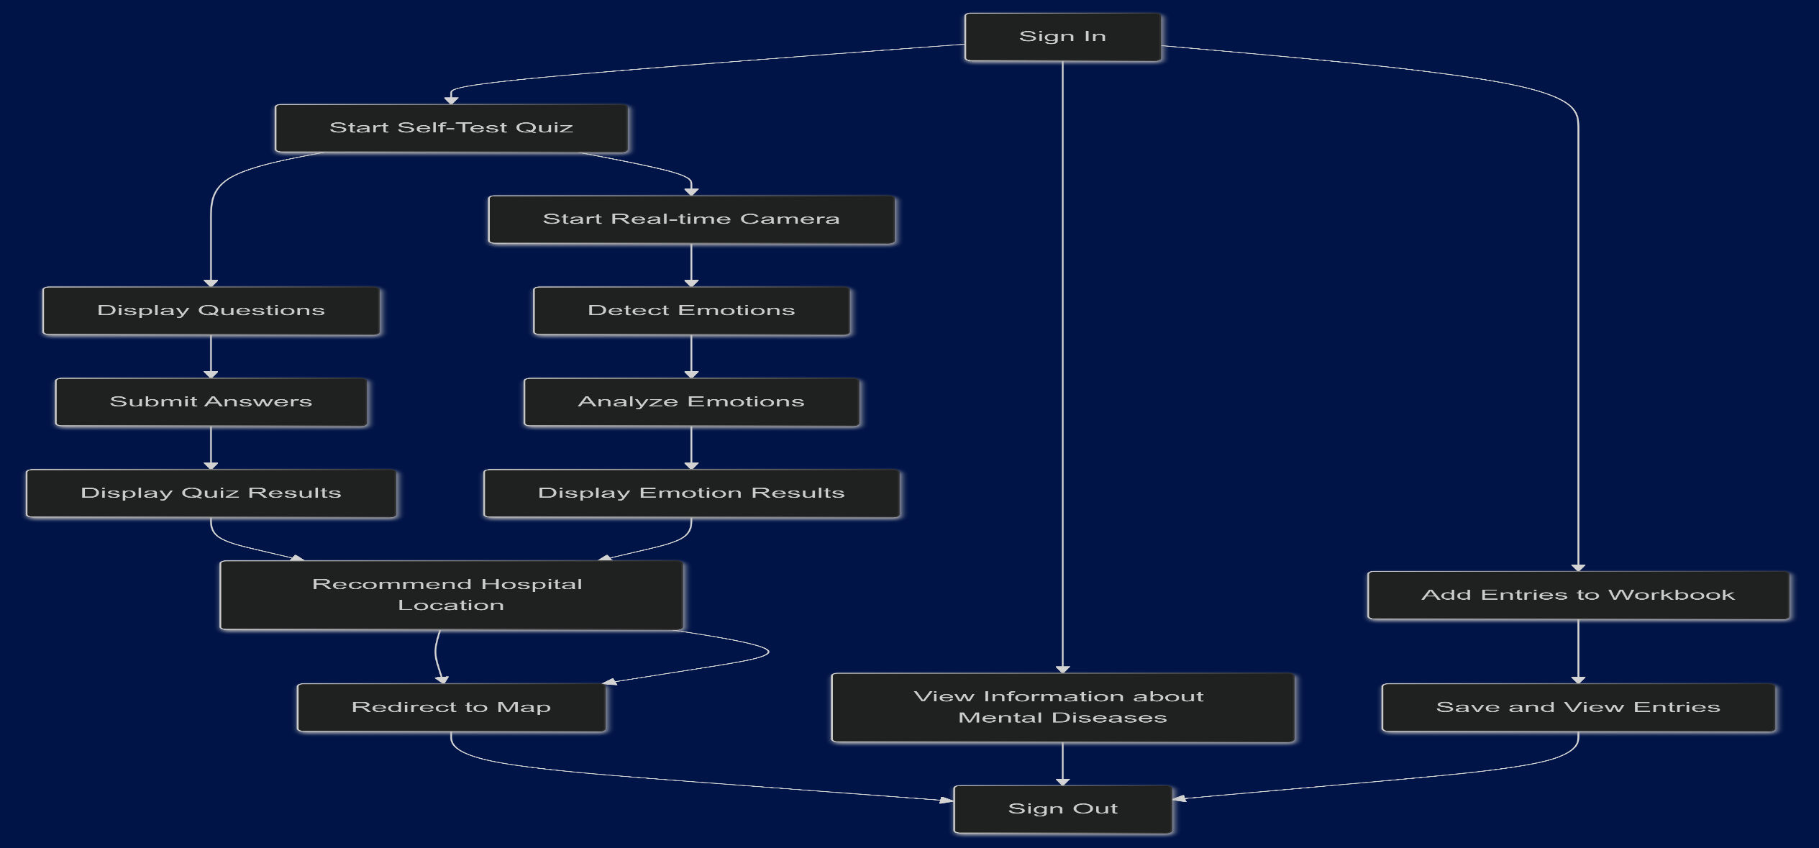
System Design [ Entire system] - Team Approach
3. Activity diagram
10/24/2024

Slide 19
Implementation and Testing
Implementation:.

Slide 20
Implementation and Testing
Implementation:.
\

Slide 21
Implementation and Testing
Implementation:.
\

Slide 22
Implementation and Testing
Implementation:.

Slide 23
Implementation and Testing
Implementation:.

Slide 24
Implementation and Testing
Implementation:.

Slide 25
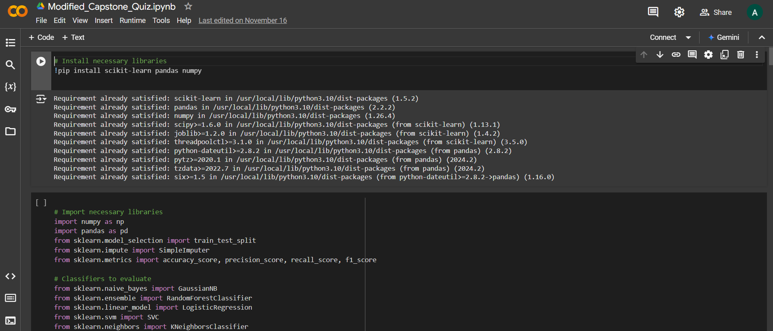
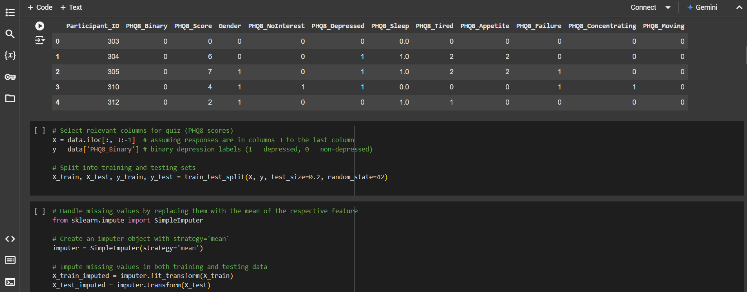
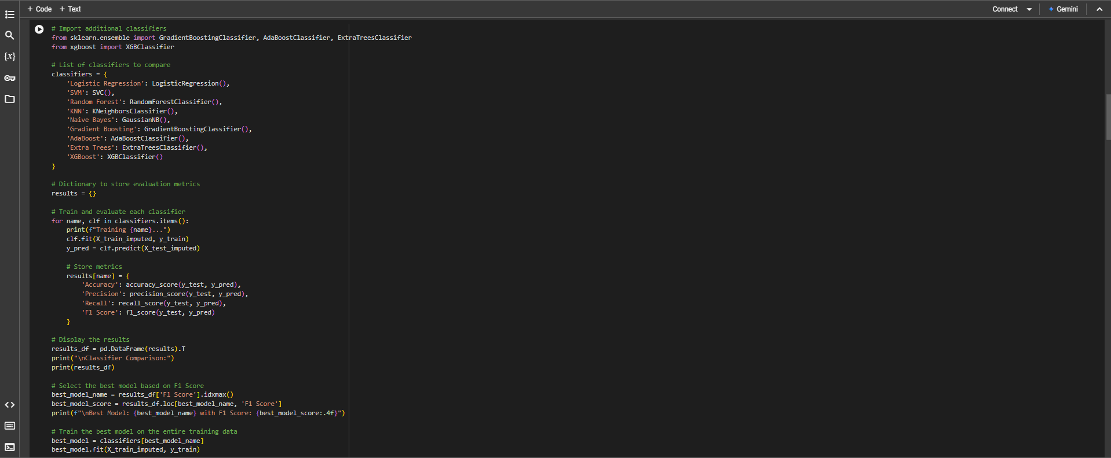
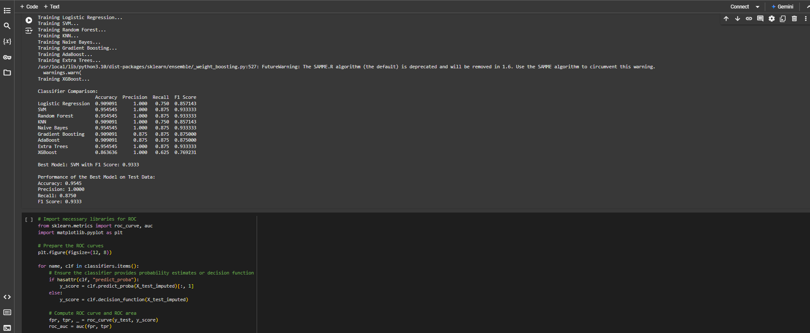
Source Code - Quiz Module
Programming Style: The code follows traditional approach of coding a machine learning classifier model with flow as: Dataset EDA -> Data normalization -> classifier initialization -> Data train-test split -> Fitting data to find best model -> models evaluation -> model selection -> final testing on actual inputs -> save and export model.

Slide 26
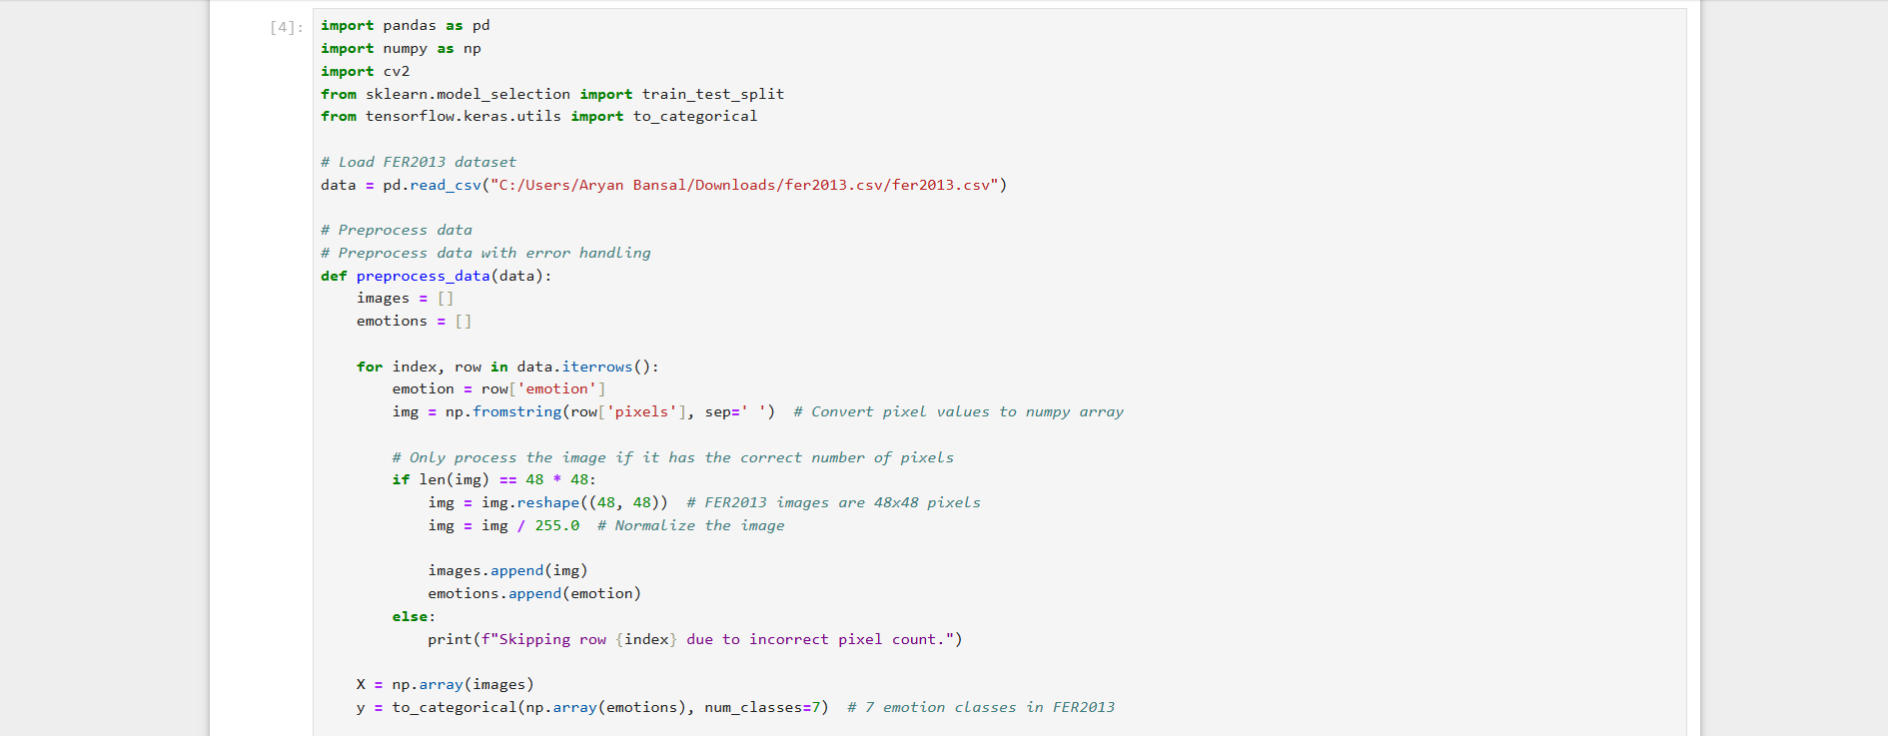
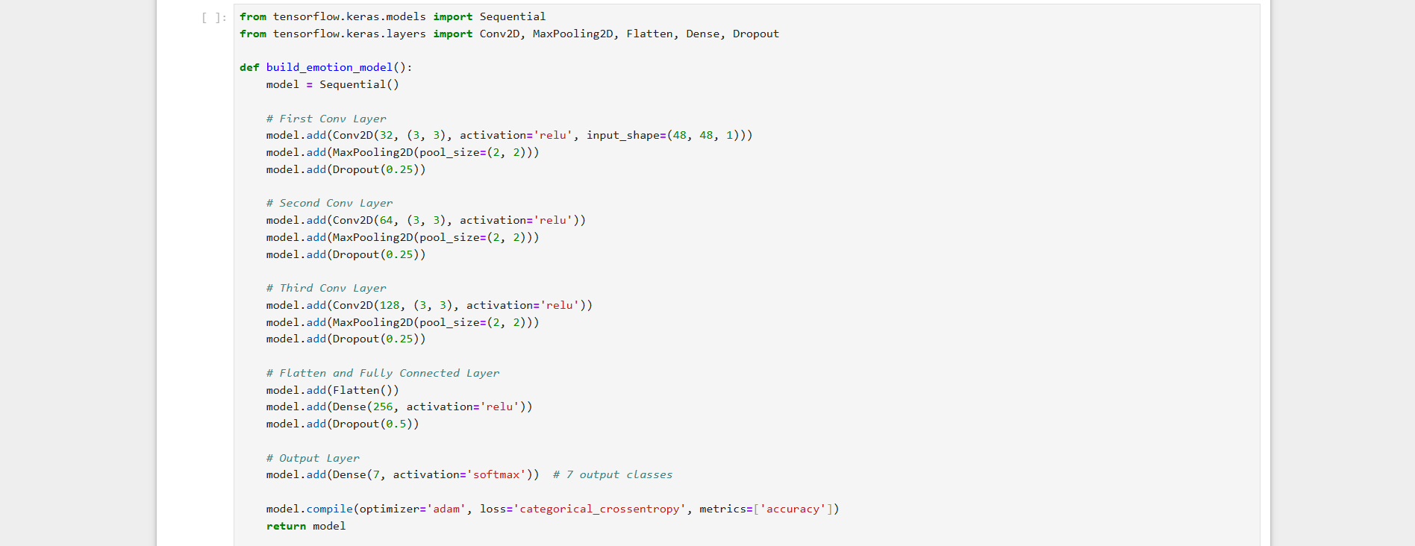
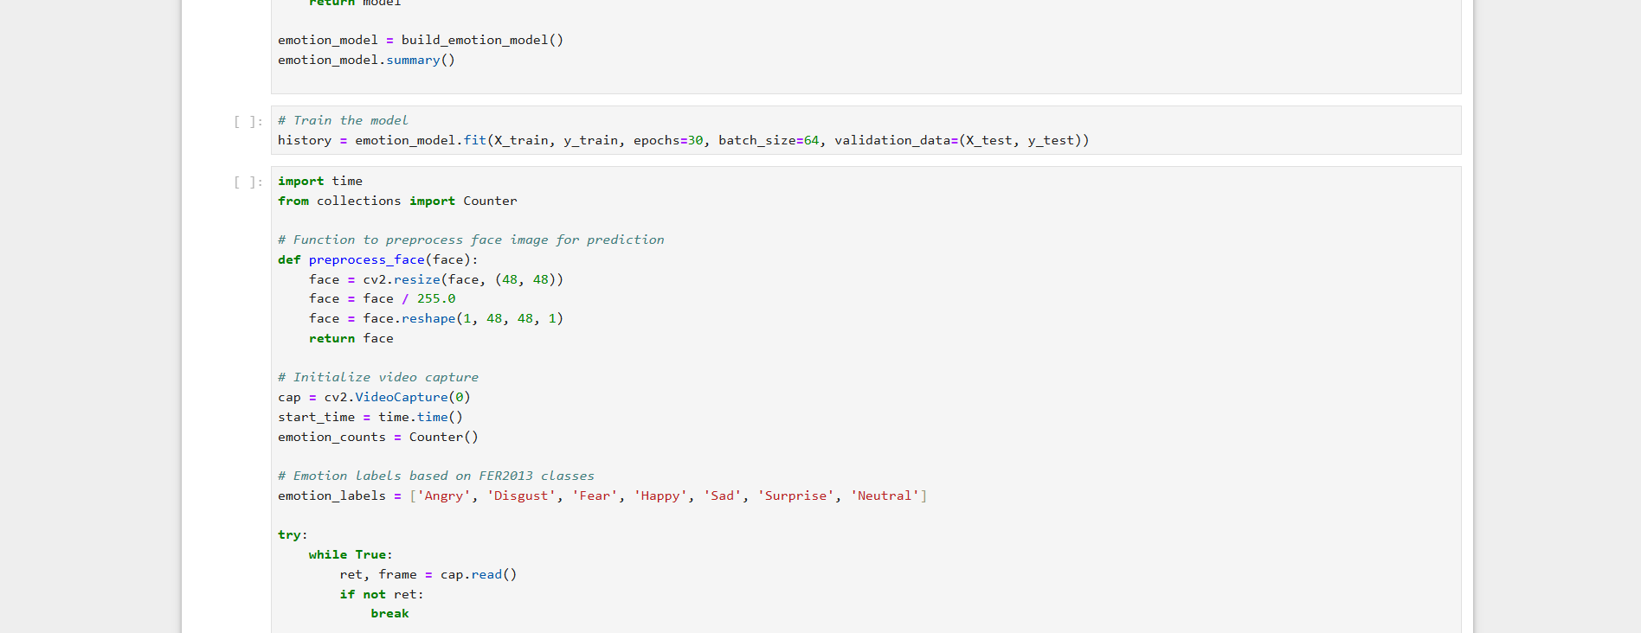
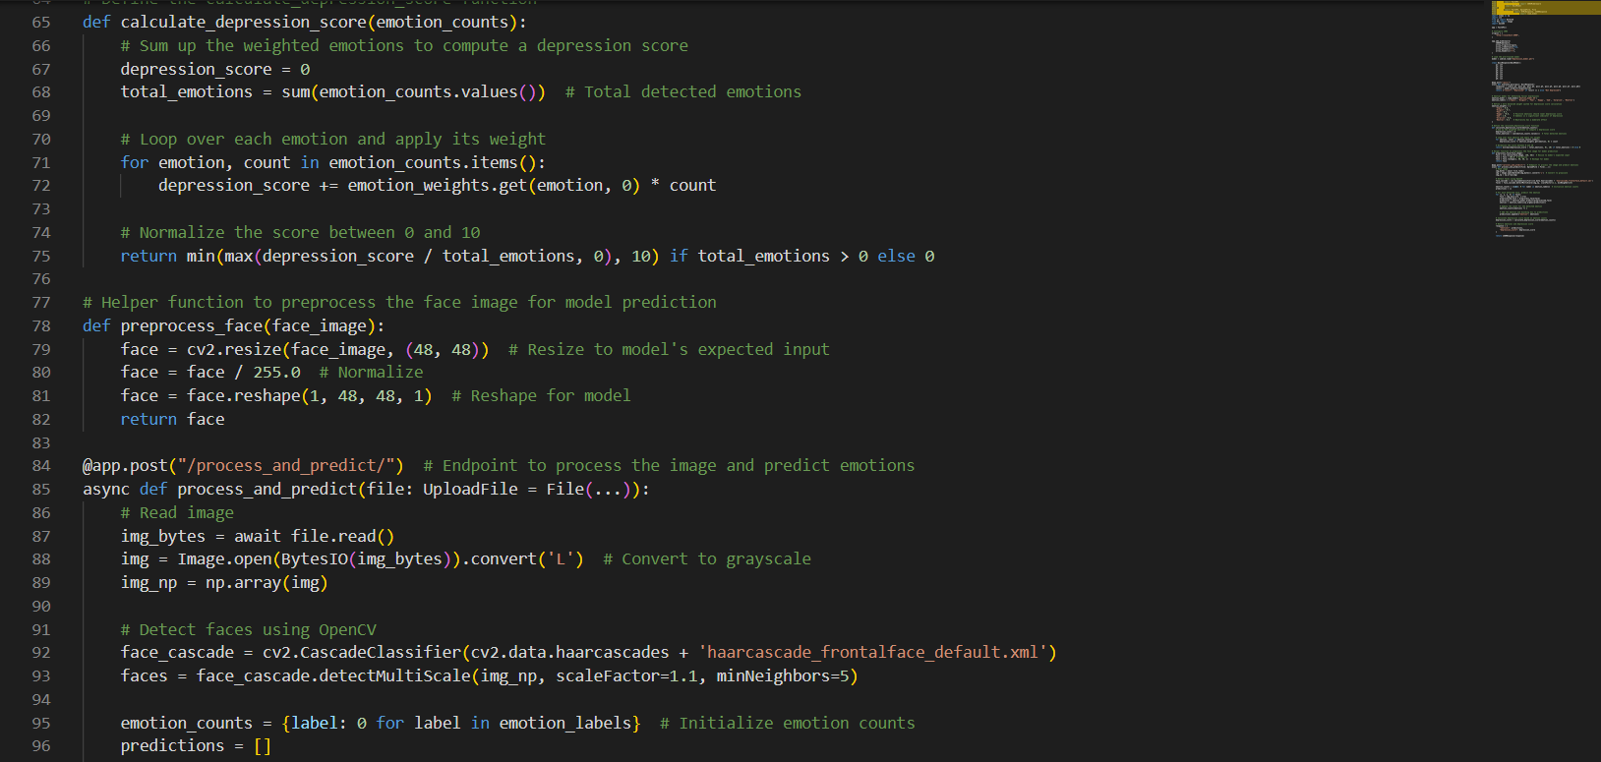
Source Code - Facial Analysis module
Programming Style: The code follows traditional approach of coding a machine learning classifier model with flow as: Dataset EDA -> Data normalization -> Defining CNN layers -> Data train-test split -> -> model training & evaluation-> Capture frame from vedio-> conversion to pixels->final testing on actual inputs -> save and export model.

Slide 27
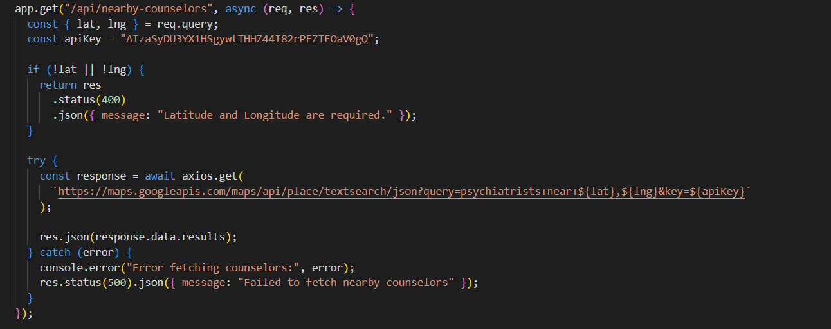
Source Code- Recommendation module
Programming Style: The code is modular with functions (fetchnearbycounsellors() & /nearby-counsellors api) dedicated to specific tasks, improving readability and maintainability. The use of descriptive variable names and organization into logical sections enhances clarity.

Slide 28
Deployment & Testing Strategies
DEPLOYMENT STRATEGIES
Start with local deployment for testing.
Cloud deployment on AWS/Heroku with Docker for scalability.
Ensure data security with encryption, authentication, and role-based access control (RBAC).
Setting up automated daily data updates can ensure the application remains relevant with minimal manual intervention. Deploying on cloud platforms like AWS or Azure with scalability in mind would ensure reliable handling of the multiple requests coming from multiple clients to the serverat peak usage time.
TESTING STRATEGIES
Unit testing for Naive Bayes, CNN, and preprocessing tasks.
Integration testing for smooth frontend-backend interactions and accurate real-time processing.
User and performance testing for real-time emotion detection, ensuring scalability and low latency.

Slide 29
Individual Details

Slide 30
Sai Venktesh Dubey
Aim : The aim is to build the quiz module in python using libraries like numpy, pandas,matplotlib, scikit-learn and classifier models like naive-bayes, random forest, SVM etc. The aim is to use DAIC-WOZ dataset to train and get best classifier among them and create a model.
Objectives
Data Cleaning & Handling: Implement data preprocessing steps to clean the dataset and transform the data for analysis
Importing and initiaizing multiple classifiers: Initialize GaussianNB(), SVC, RandomForest, Adaboost, XGBoost etc.
Comparison of all models and evaluation: Used Accuarcy, precison, Recall and F1 score to evaluate models.
Model Testing: Evaluate the model on actual data.
Export Model : Export the model using joblib to the python backend server for further usage.

Slide 31
Aryan Bansal
Aim :
[1] The aim is to build the Facial Expression based depression detection module using python and javascript. Leverage the use of CNN(Convolutional Neural Network) for facial expression recognition using the well-known FER2013(Facial Expression Recognition) dataset for detection.
[2] Designed python backend and NodeJS Backend for web app and API handling including data transfer.
Objectives
[1] Facial Expression module
EDA: Explore the dataset and features of dataset.
Construction: Construction of 5-layer deep convolutional Neural Network for feature extraction and recognition
Training/testing: Training model on FER2013 dataset for 30 epochs and testing it.
Evaluation and export: After training, evaluate and test the model on actual live feed using openCV and save
and export the model to python Backend
[2] Backend
Developed Python Backend using FastAPI to handle the ML model requests coming from Frontend.
Also developed functions to calculate the combined results of quiz and facial module.
Developed NodeJS Backend setup to handle other user operations in the web applications
Used MongoDB as the database service to store the data and design API calls to connect frontend to backend.

Slide 32
Akshit Singh
Aim :
[1] The aim is to develop the counsellor recommendation module in javascript using the Google Places API and the Geo-location API for the depressed patients.
[2] Development and implementation of basic login/signup authentication for patients/users
Objectives
[1] Counsellor recommendation
Procure the current location of user using the Geo-location API from the frontend.
Using the user coordinates, make a call to Google Places API to write the comprehensive filtered query to get the nearby
Phyciatrists/doctors data as result.
Process the data to recommend the top 5 best rated and nearby doctors from the retrieved data.
[2] Authentication
Use JWT tokens to implement authentication and authorization
Used Bcrypt.js library to hash and store passwords securely for users

Slide 33
Aerth Saraogi
Aim : The aim is to develop the user-friendly UI(User Interface) and front-end of the web-application using HTML,CSS,Bootstrap(framework) and ReactJS.
Objectives
To design the user-friendly and interactive User Interface/User experience using ReactJS.
To efficiently handle and represent the data retrieved from backend.
Use Axios to send/recieve data from python and Node backends.
Efficient client-side rendering of components.
Implemented EmailJS for efficient email service integration in support component.

Slide 34
System Design [Individually]

Slide 35
System Modules
1. Quiz Module [Sai Venktesh Dubey]:
- A diagnostic quiz using a Naive Bayes classifier to assess depression types (anxiety, PTSD, bipolar disorder) based on user responses. It provides treatment recommendations and resources.
2. Facial Expression Analysis Module [Aryan Bansal]:
- Uses a CNN to analyze users' facial expressions from a one-minute video, detecting emotional states to refine the diagnosis.
3. Recommendation Module [Akshit Singh]:
- Combines quiz and facial analysis results to suggest nearby clinics and psychiatrists, along with tailored treatment options, displayed on an interactive map.
4. Front-End / Backend for web-app [Aerth Saraogi]
10/24/2024

Slide 36
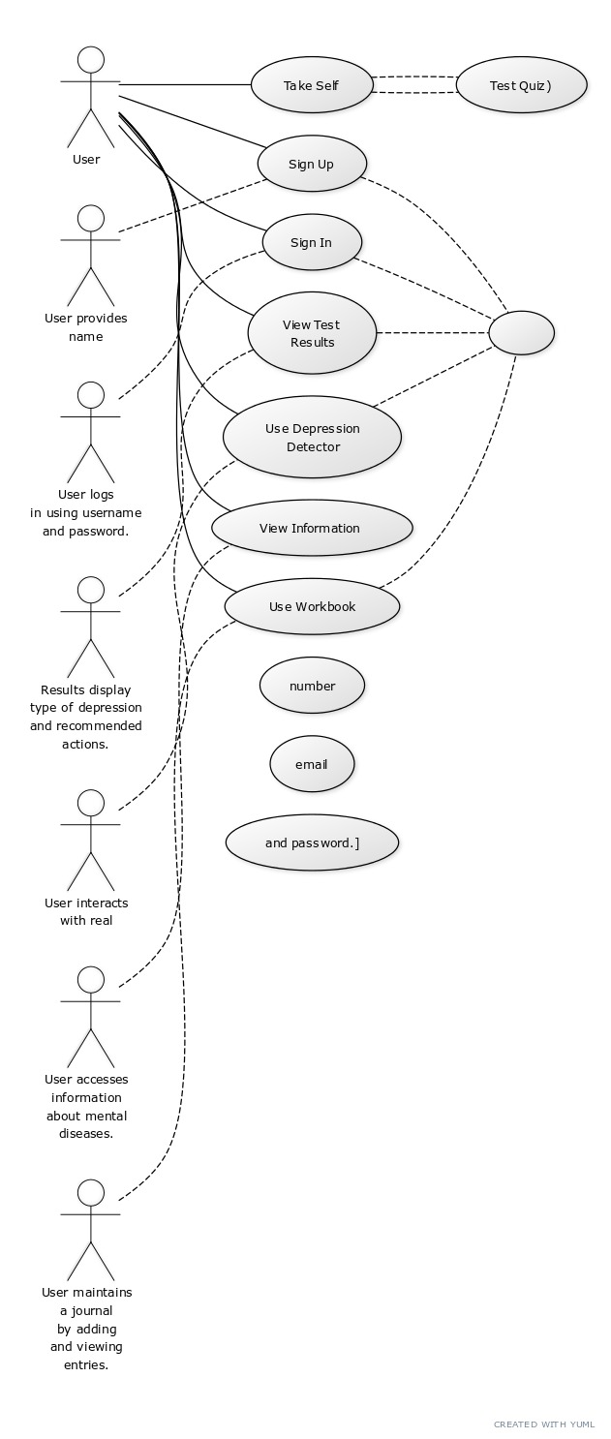
System Design – Quiz Module
1. Use-case diagram
10/24/2024

Slide 37
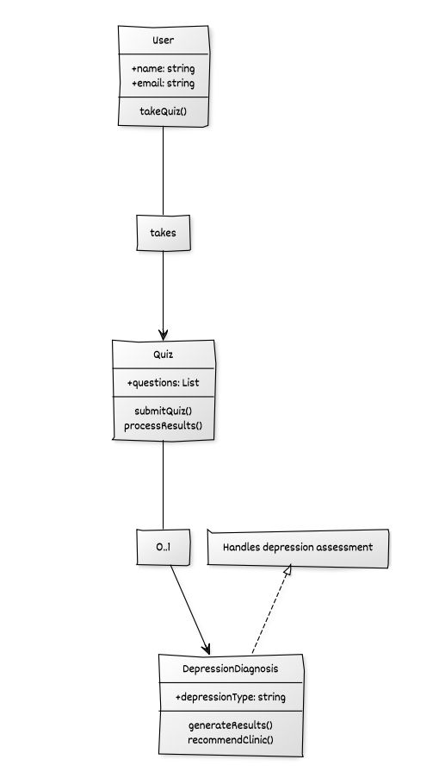
System Design – Quiz Module
2. Class diagram
10/24/2024

Slide 38
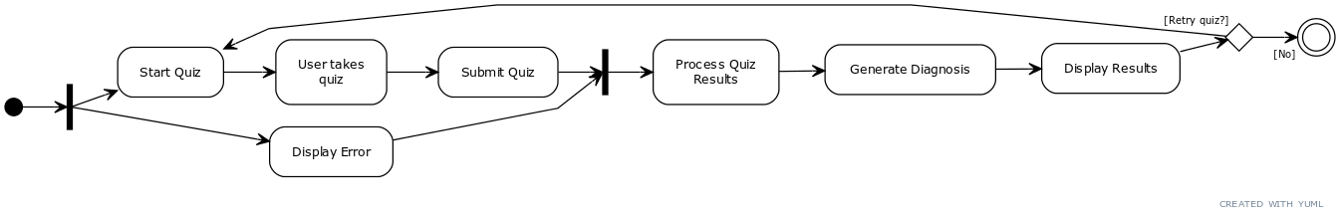
System Design – Quiz Module
3. Activity diagram
10/24/2024

Slide 39
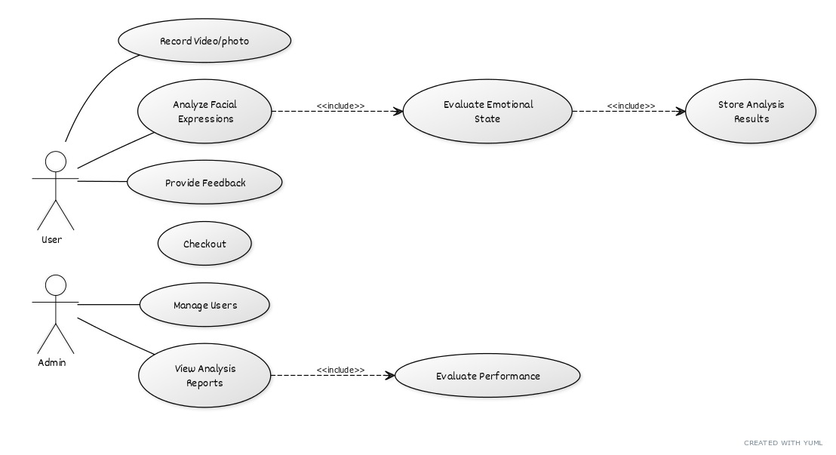
System Design – Facial expression Module
1. Use-case diagram
10/24/2024

Slide 40
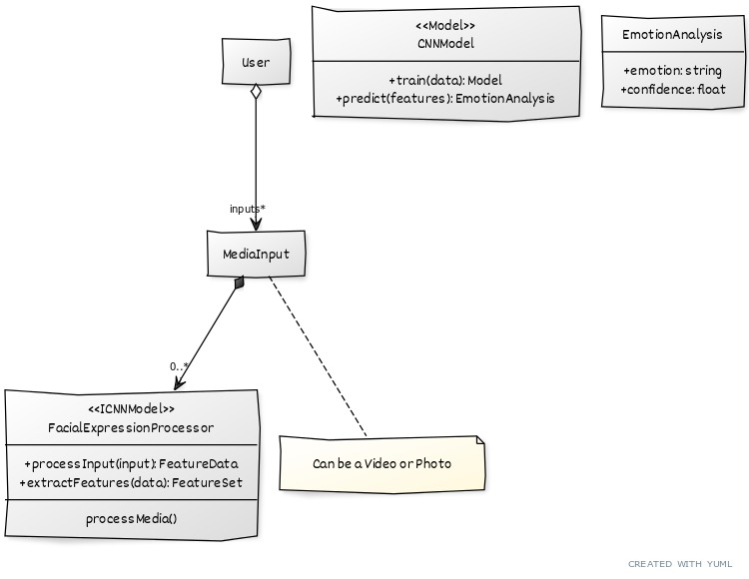
System Design – Facial expression Module
2. Class diagram
10/24/2024

Slide 41
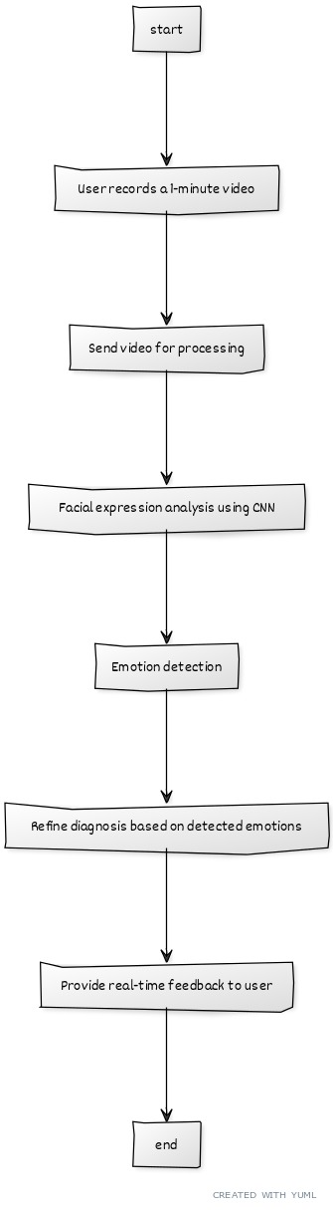
System Design – Facial expression Module
3. Activity diagram
10/24/2024

Slide 42
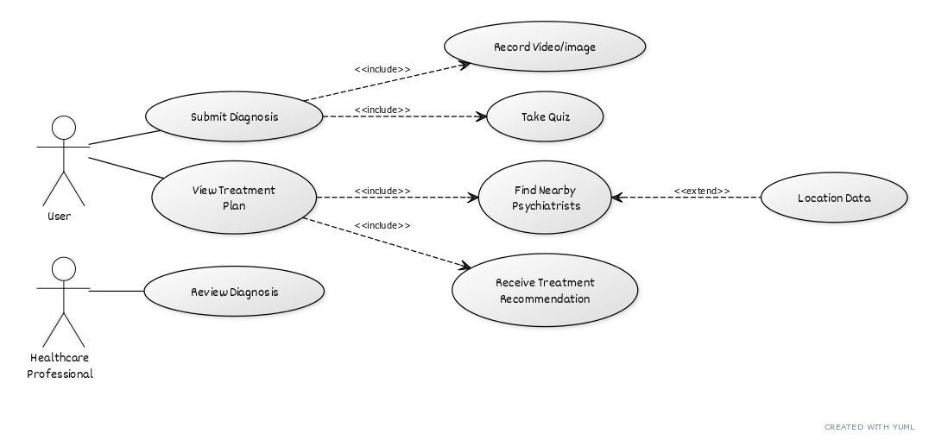
System Design – Recommendation Module
1. Use-case diagram
10/24/2024

Slide 43
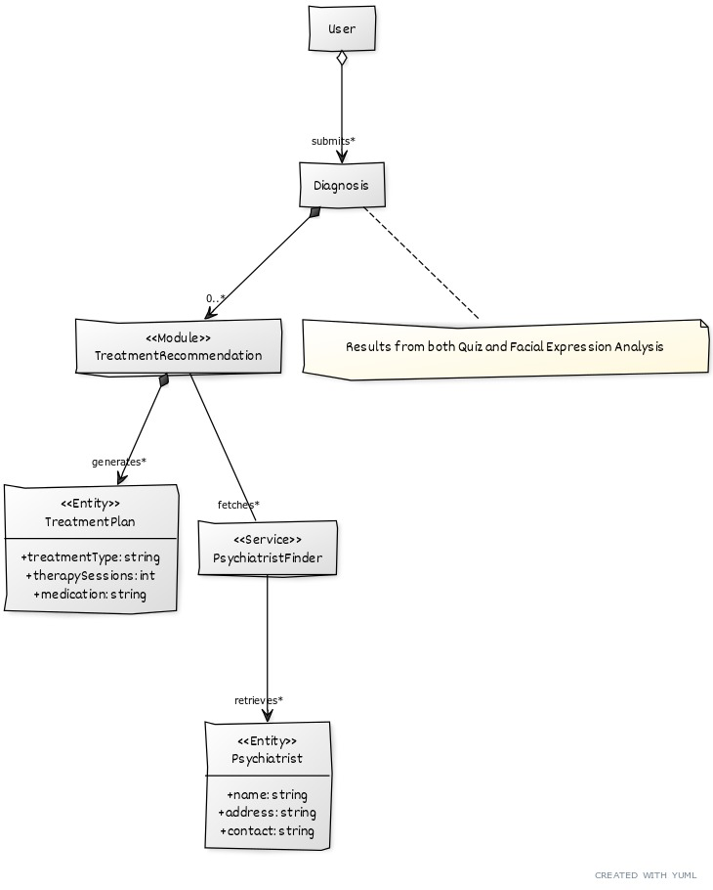
System Design – Recommendation Module
2. Class diagram
10/24/2024

Slide 44
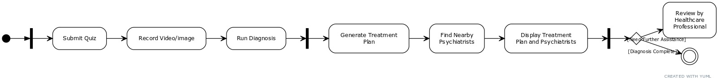
System Design – Recommendation Module
3. Activity diagram
10/24/2024

Slide 45
Dependency of Modules
Quiz → Recommendation: Quiz results provide the foundation for personalized treatment recommendations.
Facial Expression Analysis → Recommendation: Refines diagnosis for more accurate suggestions.
Recommendation Module: Relies on combined inputs from Quiz and Facial Analysis to suggest clinics and treatments
All of them are dependent upon the inputs received from user through quiz inputs and video/image.
10/24/2024

Slide 46
Future Aspects
Future Integrations
We may use the more advanced models for our tasks or we aim to optimize the current processes but identifying more robust techniques.
Testing Strategies
Unit testing for Naive Bayes, CNN, and preprocessing tasks.
Integration testing for smooth frontend-backend interactions and accurate real-time processing.
User and performance testing for real-time emotion detection, ensuring scalability and low latency.
10/24/2024

Slide 47
Future Aspects
Deployment Strategies
Start with local deployment for testing.
For initial phase, we will deploy react frontend and nodejs backend on ‘Vercel’ and FastApi Backend on ‘Render’.
Cloud deployment on AWS EC2(VM) with Docker for scalability.
Ensure data security with encryption, authentication, and role-based access control (RBAC).
10/24/2024

Slide 48
Publication details
Details on Literature Review Paper
The review paper titled "Depression Detection System using Python" examines traditional methods like the PHQ-8 questionnaire, which lack real-time capabilities and emotional analysis. It highlights technological gaps in existing models, such as challenges with class imbalance and accuracy in emotion detection. The paper emphasizes the potential of integrating Convolutional Neural Networks (CNNs) for facial expression analysis and Naive Bayes for quiz-based assessments in automated depression detection. Future improvements in data processing and the integration of psychological and physiological data are recommended to enhance detection accuracy. Ultimately, the paper advocates for a combined approach using quizzes and real-time facial analysis for more effective depression detection.
10/24/2024

Slide 49
Publication details
Details of Future planning for Implementation Paper
The implementation plan for the Depression Detection System includes several key stages. Initially, the focus will be on integrating the Naive Bayes classifier for quiz assessments and the Convolutional Neural Network (CNN) for facial expression analysis using FastAPI for seamless frontend-backend communication. Next, real-time facial analysis will be implemented to provide immediate feedback. The user interface will be developed with ReactJS for a user-friendly experience, while data management will utilize MongoDB to ensure secure storage and privacy. Testing will encompass unit, integration, and user testing, followed by deployment on cloud platforms for scalability. Future enhancements may include integrating wearable health device data and expanding diagnostic capabilities.
10/24/2024

Slide 50
References
[1]. L. Mariñelarena Dondena, E. Ferretti, M. Maragoudakis, M. Sapino, and M. Errecalde, "Predicting Depression: A Comparative Study of Machine Learning Approaches Based on Language Usage," Journal, 2017.
[2]. L. Ansari, S. Ji, C. Qian, and E. Cambria, "Ensemble Hybrid Learning Methods for Automated Depression Detection," Journal, 2023.
[3]. M. Raeiati Banadkooki, C. Mielke, K.-H. Wolf, R. Haux, and M. Marschollek, "Automatic Detection of Depression by Using a Neural Network," Journal, 2018.
[4]. U. Chawda and S. Rakesh, "Implementation and Analysis of Depression Detection Model Using Emotion Artificial Intelligence," Journal, 2019.
[5]. R. Salas-Zárate, G. Alor-Hernández, M. P. Salas-Zárate, M. A. Paredes-Valverde, M. Bustos-López, and J. L. Sánchez-Cervantes, "Depression Detection on Social Media," Journal, 2022.
[6] D.-D. Yan, L.-L. Zhao, X.-W. Song, X.-H. Zang, and L.-C. Yang, "Automated Detection of Clinical Depression Based on Convolution Neural Network Model," Journal, 2022

Slide 51
References
[7]. V. Maheshwar, N. Venu Gopal, V. Naveen Kumar, D. Pranavi, and Y. Padma Sai, "Development of an SVM-Based Depression Detection Model Using MFCC Feature Extraction," Journal, 2022.
[8]. M. R. Hidayatullah and W. Maharani, "Depression Detection on Twitter Social Media Using Decision Tree," Journal, 2022.
[9]. V. Bastos and A. F. Monteiro, "Detection of Depression Symptoms Using Chatbots Based on Machine Learning," Conference Paper, 2020.
[10]. M. Patil, V. M. Wadhai, D. H. Gawali, and A. S. Chanchlani, "Intelligent Depression Detection System Using Effective Hyper-Scanning Techniques," Journal, 2020.
[11]. M. Rizwan, P. Rani, and J. Patel, "A Hybrid Model for Depression Detection Using Visual and Linguistic Data," Journal, 2021.
[12]. A. Singh, R. K. Gupta, and N. Goyal, "Real-Time Depression Detection Using Wearable Device Data," Journal, 2021.

Slide 52
References
[13]. L. Zhao, H. Zhu, and Q. Li, "Transfer Learning for Depression Detection: A Model for Low-Resource Environments," Journal, 2021.
[14]. P. Mehta and S. Saxena, "Deep Learning Framework for Sentiment Analysis on Social Media Data for Depression Detection," Journal, 2020.
[15]. Z. Liu, J. Chen, and Y. Zhou, "Multimodal Deep Learning for Real-Time Depression Detection Using EEG and Facial Analysis," Journal, 2023.

Slide 53

10/24/2024

